Slide 1
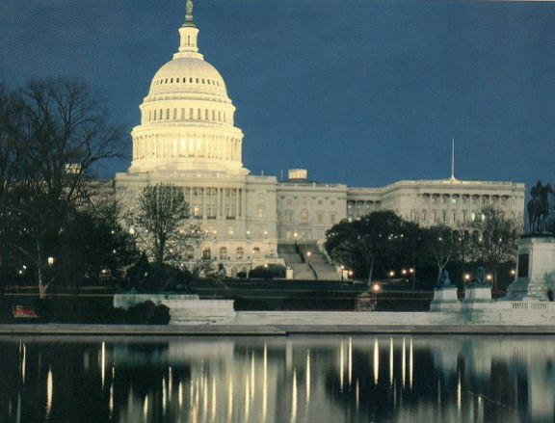
How Congress Works Part I
Structure, Organization, & Legislative Process

Slide 2
What do members of Congress do all day?

Slide 3
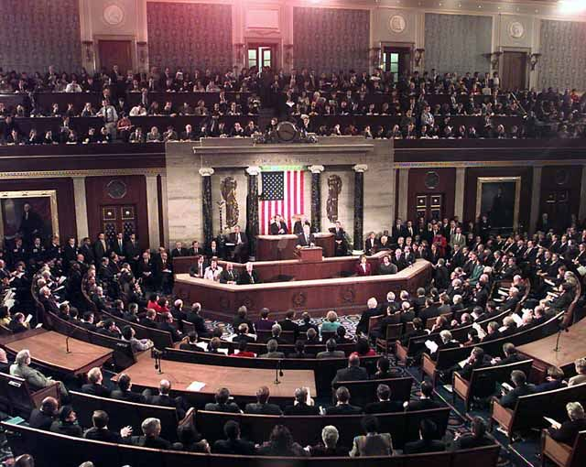
Who’s in Congress?

Slide 4
 | House | Senate | U.S. |  | House | Senate | U.S.
Party * |  |  |  | Gender
Democrat | 57% | 44% | 31% | Male | 80% | 80% | 49%
Republican | 44% | 54% | 25% | Female | 20% | 20% | 51%
Independent | 0% | 2% | 42% | Race/Ethnicity
Age | 57 | 61 | 37 | Caucasian | 79.8 | 93% | 62%
Occupation |  |  |  | African American | 8.9% | 2% | 13%
Public Service/Politics | 271 | 60 |  | Hispanic/Latino | 7.8% | 4% | 18%
Business | 231 | 42 |  | Asian/Pacific Islander | 3.0% | 1% | 6.6%
Law | 151 | 51 |  | American Indian | 0.5% | 0 | 1
Education | 80 | 25 |  | Foreign Born | 3.0% | 3% | 12.90%
Religion |  |  |  | Education
Protestant | 58% | 55% | 52% | Bachelor's Degree | 94% | 100% | 29%
Catholic | 32% | 26% | 23% | Educ. beyond BA/BS | 64% | 74%
No religious identity | n/a | n/a | 16%
Jewish | 4% | 9% | 2%
Mormon | 2% | 7% | 2%
Buddhist | 0% | 1% | n/a
Muslim | 0% | 0% | 1%
Hindu | 0% | 0% | n/a
Other non-Christian | n/a | n/a | 3%
Total | 97% | 98% | 95%
When comparing House and Senate v. U.S. what differences do you notice?
Is it OK that Congress isn’t entirely representative of the U.S. population?
What are three (3) reasons why you think Congress does not directly reflect the U.S. population

Slide 5
How are the House and Senate different? Similar?

Slide 6
House-Senate Differences
House
435 members; 2 yr terms
Low turnover
Speaker bill referral hard to challenge
Scheduling/rules controlled by majority party with powerful Rules Committee (controls time of debate, amends., etc)
Senate
100 members; 6 yr terms
Moderate turnover
Referral decisions easily challenged
Scheduling/rules agreed to by majority & minority leaders

Slide 7
House-Senate Differences
House
Debate limited to 1 hour
Members’ policy specialists
Emphasizes tax & revenue policy
More formal & impersonal
Senate
Unlimited debate unless cloture invoked
Members’ policy generalists
Emphasizes foreign policy
More informal & personal

Slide 8
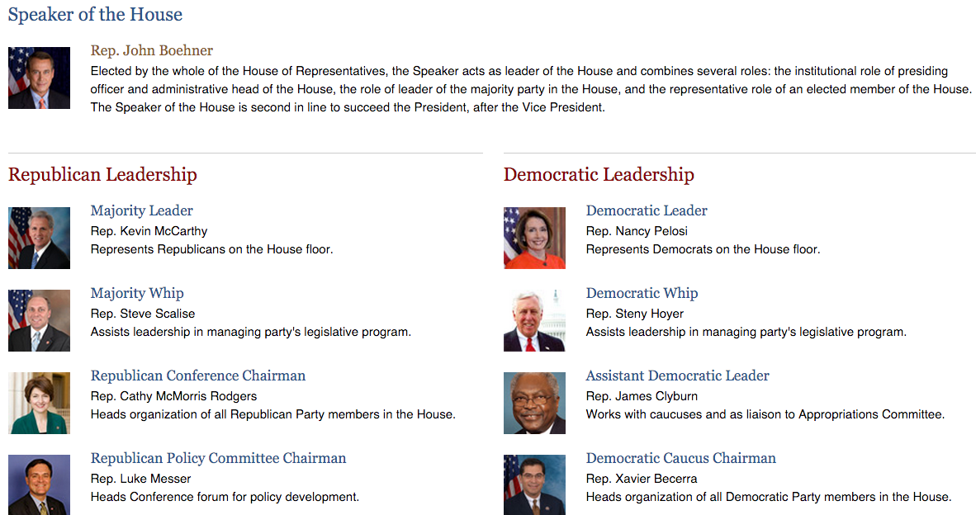

Slide 9
Senate Leadership

Slide 10
Powers of the House
Power to impeach
bring charges against federal officials
Power to decide presidential election if there’s a tie in Electoral College
Tax bills originate in the House
start 2:13

Slide 11
Powers of the Senate
Impeachment trial
Ratify (approve) treaties
2/3rds (67)
Confirmation powers
start 3:14

Slide 12
School House Rock

Slide 13
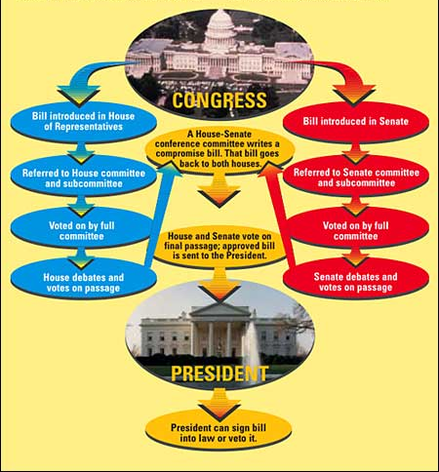

Slide 14
"Congress in session is Congress on public exhibition, whilst Congress in its committee-rooms is Congress at work.”
- Woodrow Wilson

Slide 15
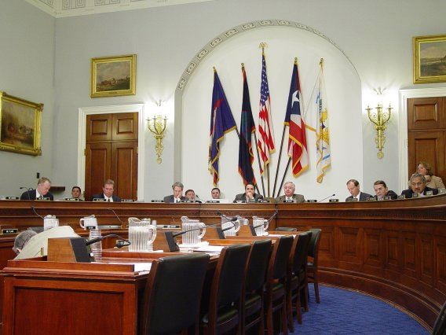
Legislative Committees:
Function and Purpose

Slide 16
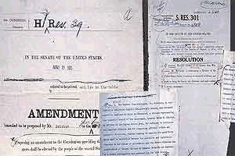
Legislative Committees: Function & Purpose
1. Consider bills (a.k.a. “mark-up” bills)
A bill with a member’s mark-up notes

Slide 17
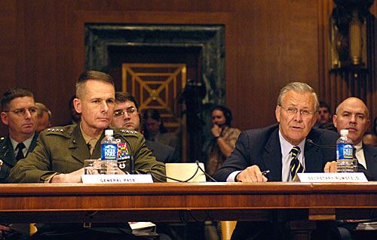
Legislative Committees: Function & Purpose
2. Maintain oversight of executive agencies
Secretary Donald Rumsfeld testifies before a Senate Appropriations Committee hearing re: the Department of Defense Budget (May, 2006)

Slide 18
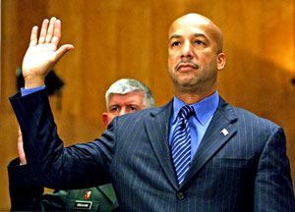
Legislative Committees: Function & Purpose
3. Conduct investigations
New Orleans Mayor Ray Nagin testified before the Senate Homeland Security and Governmental Affairs Committee on Hurricane Katrina (Feb., 2006

Slide 19
Types of Committees
Standing Committees - permanent panel with full legislative functions and oversight responsibilities
Subcommittees – formed to tackle very specific tasks within the jurisdiction of the full committees
Select or Special Committees - groups appointed for a limited purpose and limited duration
Joint Committees - includes members of both chambers to conduct studies or perform housekeeping tasks
Conference Committee - includes members of House & Senate to work out differences between similar bills

Slide 20
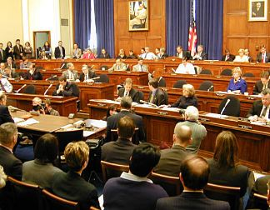
Standing Committees

Slide 21
House Standing Committees
Agriculture
Appropriations
Armed Services
Budget
Education & Workforce
Energy & Commerce
Financial Services
Government Reform
House Admin.
International Relations
Judiciary
Resources
Rules
Science
Small Business
Standards of Official Conduct
Transportation & Infrastructure
Veterans Affairs
Ways & Means

Slide 22
Senate Standing Committees
Agriculture, Nutrition, & Forestry
Appropriations
Armed Services
Banking, Housing, & Urban Affairs
Budget
Commerce, Science, Transportation
Energy & Natural Resources
Environment and Public Works
Finance
Foreign Relations
Governmental Affairs
Health, Education, Labor & Pensions
Judiciary
Rules and Administration
Small Business and Entrepreneurship
Veterans Affairs

Slide 23
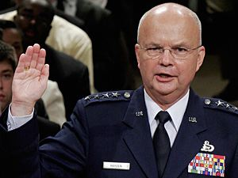
Special, Select Committees
House Select Committee on Energy Independence & Global Warming
Senate Select Committee on Ethics
House & Senate Select Committees on Intelligence
Gen. Michael Hayden is sworn in during a full committee hearing of the Senate Select Intelligence Committee on his nomination to be director of the Central Intelligence Agency.

Slide 24
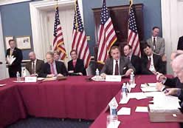
Joint Committees
Joint Economic Committee
Joint Committee on Printing
Joint Committee on Taxation
Joint Committee on Taxation hearing

Slide 25
Videos

